Slide 1
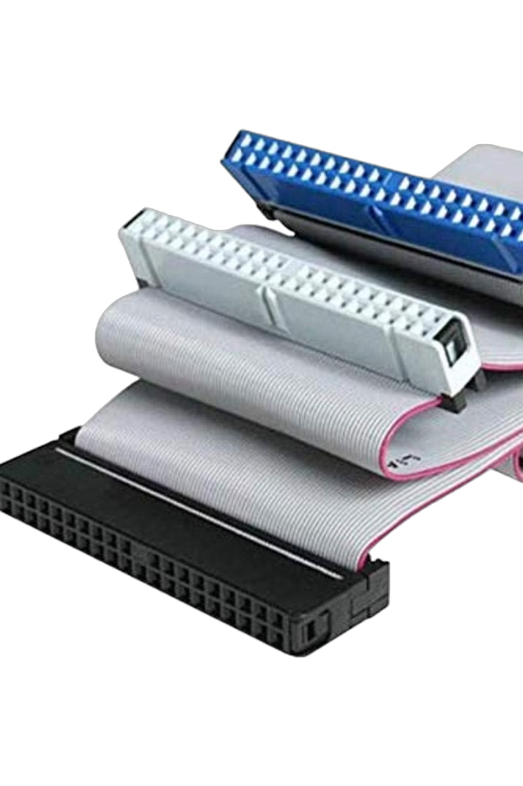

PATA: A Look Back at Parallel ATA
Parallel Advanced Technology Attachment (PATA) was a standard for connecting storage devices to motherboards, such as hard drives and optical discs.
by Nika Ghaderi
1

Slide 2
Table of contents
PATA's History and Evolution
Sample Usage
PATA's Architecture and Signaling
PATA's Architecture and Signaling (cont'd)
PATA's Architecture and Signalingv (cont'd)
PATA's Architecture and Signaling (cont'd)
PATA's Architecture and Signaling (cont'd)
PATA Dual-Drive Configurations
PATA vs SATA
PATA's Legacy
Thank you for your attention!
2

Slide 3
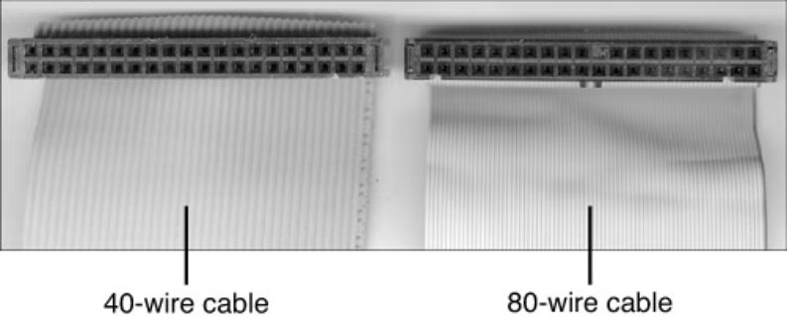
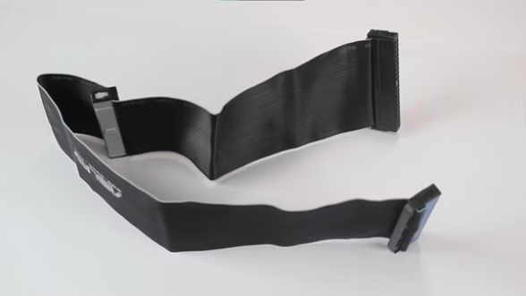
PATA's History and Evolution
Early Days
Evolution
Invented by Western Digital in 1986, originally called Integrated Drive Electronics (IDE).
ATA 1,2,4,6 and 7
Speed up to 133 MB/s
Speed up to 16 MB/s
Support for CD-ROMs and other devices
3

Slide 4
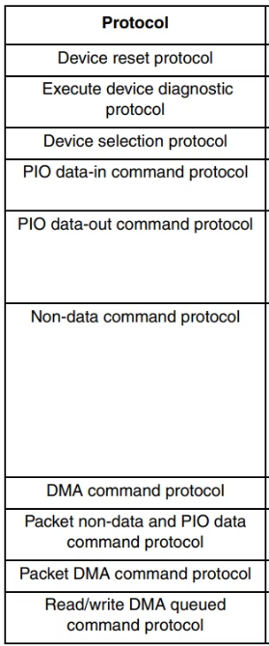
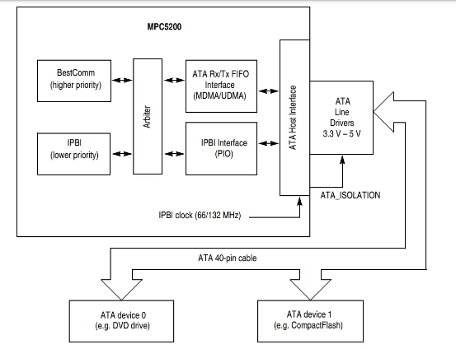
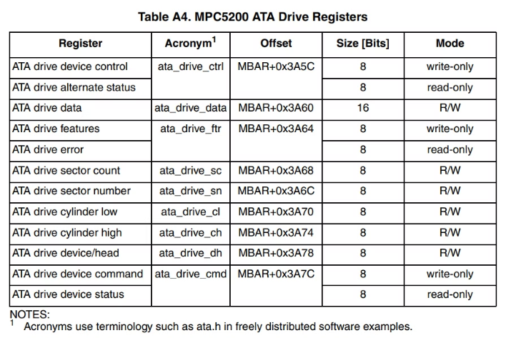
Sample Usage
4

Slide 5



PATA's Architecture and Signaling
Transaction Layer
1
Manages command execution, data transfers, and device coordination.
Data Link Layer
2
Manages data framing, error detection, and flow control between host and device.
Physical Layer
3
Defines electrical and mechanical characteristics, including signaling, cabling, connectors, and timing.
5

Slide 6
PATA's Architecture and Signaling (cont'd)
Physical Layer
Signaling
Cabling
Single-ended signaling (not differential).
40-pin ribbon cable: 16 data lines + control/ground.
Voltage levels: 5V (older) or 3.3V (newer).
Susceptible to noise and crosstalk.
80-conductor cable: Reduced crosstalk (ATA/66+).
Max length: 18 inches (45 cm).
Connectors
Timing
40-pin IDC connector.
Synchronized using strobe signals (DIOR#, DIOW#).
Master/Slave configuration via jumpers.
Data rates: 16.6 MB/s (ATA-1) to 133 MB/s (ATA-7).
6

Slide 7
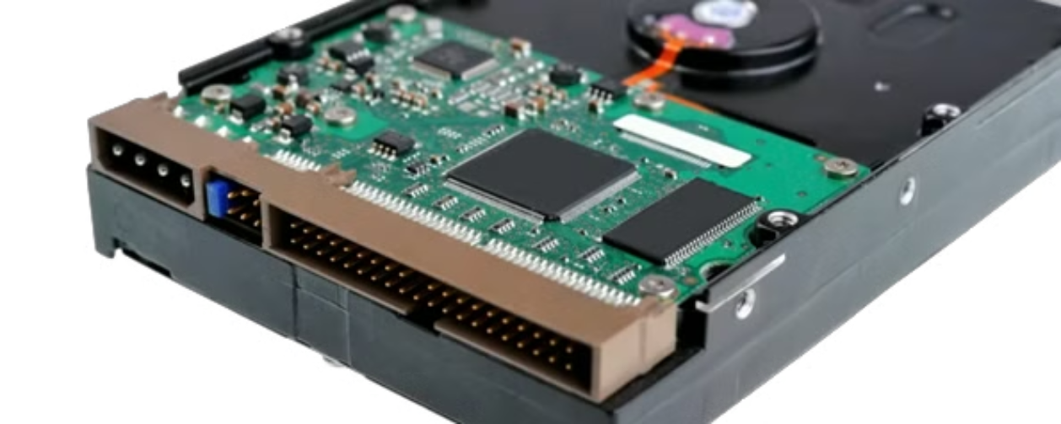
PATA's Architecture and Signalingv (cont'd)
Physical Layer
7

Slide 8
PATA's Architecture and Signaling (cont'd)
Data Link Layer
Data Framing
Error Detection
16-bit parallel transfers.
CRC for data integrity.
Block transfers (512-byte sectors).
Optional parity checking.
Flow Control
Protocol Commands
IORDY signal for pausing host.
Basic commands: Identify Device, Read/Write Sector
8

Slide 9
PATA's Architecture and Signaling (cont'd)
Transaction Layer
Command Execution
Data Transfer Modes
ATA commands via Task File Registers.
PIO: CPU-managed (slower).
Parameters: Sector count, LBA (3), operation type.
DMA: Direct to memory (faster).
UDMA: Enhanced DMA with CRC.
Task File Registers
Master/Slave Arbitration
Configure commands (e.g., Read Sector).
Manages communication for shared cables.
9

Slide 10
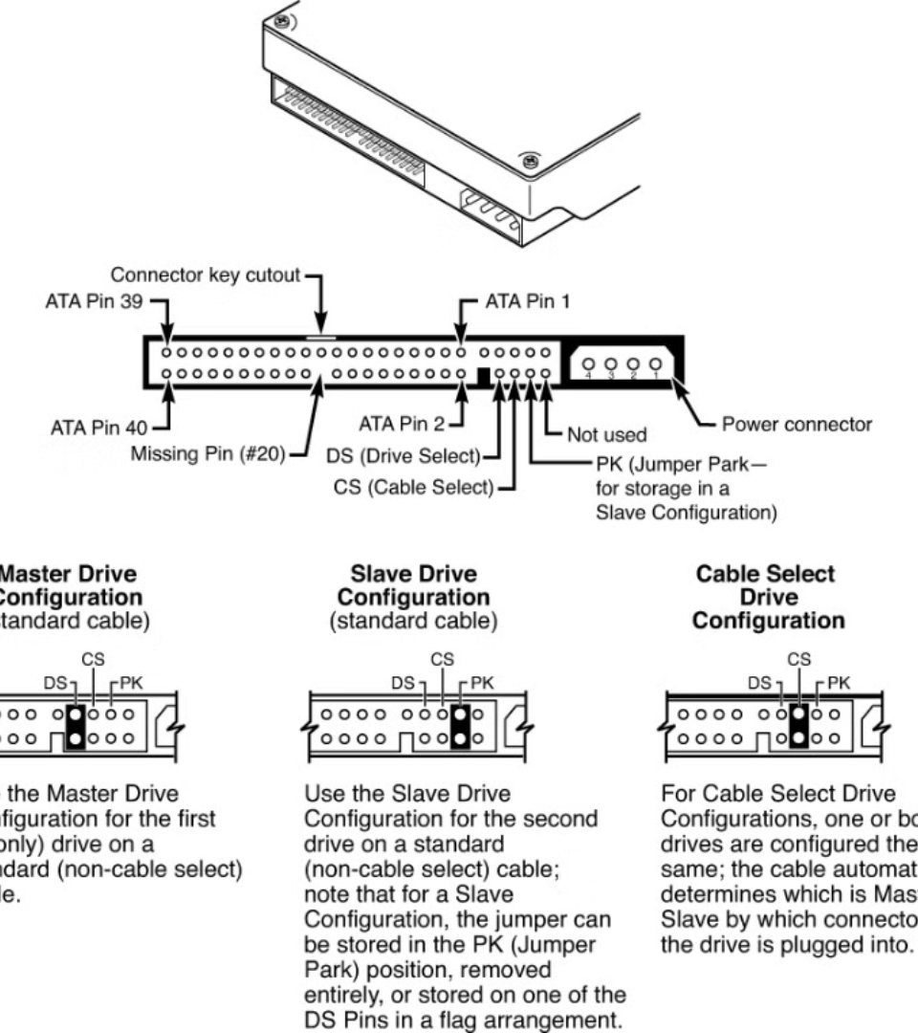


PATA Dual-Drive Configurations
Device Designation
Device 0 (Master) and Device 1 (Slave). (No priority and dependance)
Share the same bus.
Only one controller responds to commands at a time. (DRV)
Jumper Settings
Device 0/1 or Cable Select (CS).
CS: Automatically assigns device based on cable position.
Default: Usually Cable Select (if no jumpers are set).
10

Slide 11
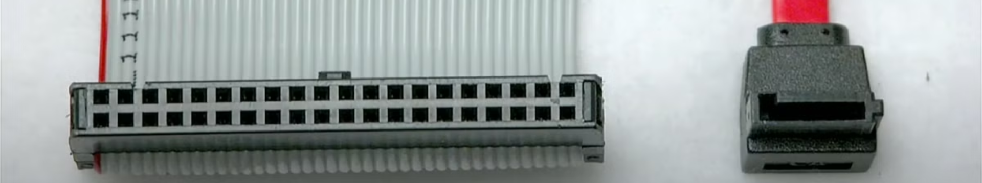





PATA vs SATA
2
Cable Length: SATA (1m) > PATA (46cm).
Transfer Speed: SATA > PATA.
1
Performance: SATA supports hot-swapping; PATA does not.
3
Versatility: PATA connects 2 devices per cable; SATA has 2 ports.
5
Compatibility: SATA supports forward/backward compatibility.
4
11

Slide 12

PATA's Legacy
PATA played a crucial role in the development of computer storage technology, paving the way for faster and more versatile interfaces like SATA. While PATA is no longer widely used, its impact on the evolution of computer hardware remains significant.
12

Slide 13
Thank you for your attention!
Under the guidance of Dr. Foshati
Interface Circuits Design
Sharif University of Technology
Fall 2024
13

